Slide 2
Connectors and Wiring Standards

Slide 3
Table of Contents
Physical Media
Cable Properties

Slide 4
Physical Media
1

Slide 5
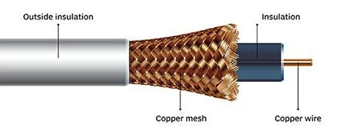

Coaxial Cable
A type of copper cable specially built with a metal shield and other components engineered to block signal interference
Inexpensive
Resistance to EMI
Easy to install
Up to 10 Mbps
Easy to expand
Durable
Notes:
Coaxial cable is a type of copper cable specially built with a metal shield and other components engineered to block signal interference. It is primarily used by cable TV companies to connect their satellite antenna facilities to customer homes and businesses. It is also sometimes used by telephone companies to connect central offices to telephone poles near customers. Some homes and offices use coaxial cable, too, but its widespread use as an Ethernet connectivity medium in enterprises and data centers has been supplanted by the deployment of twisted pair cabling.
Advantages of coaxial cable
Inexpensive
Easy to wire and install
Easy to expand
Good resistance to EMI (Electromagnetic Interference)
Up to 10Mbps capacity
Durable

Slide 6
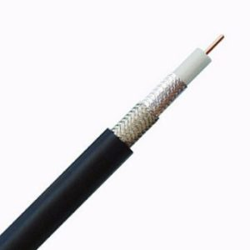
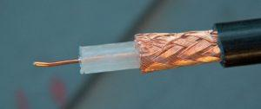
Coaxial Cable
There are two types of coaxial cable:
Thicknet (10Base5) Thinnet (10Base2)
Thicknet and thinnet are used in Ethernet implementations
Notes:
Thin Ethernet (also referred to as Thinnet or 10Base2) and Thick Ethernet (also referred to as Thicknet or 10Base5 are coaxial cable types. They have the same properties except for the thickness of the cables is different.
Thicknet and thinnet are used in Ethernet implementations.

Slide 7
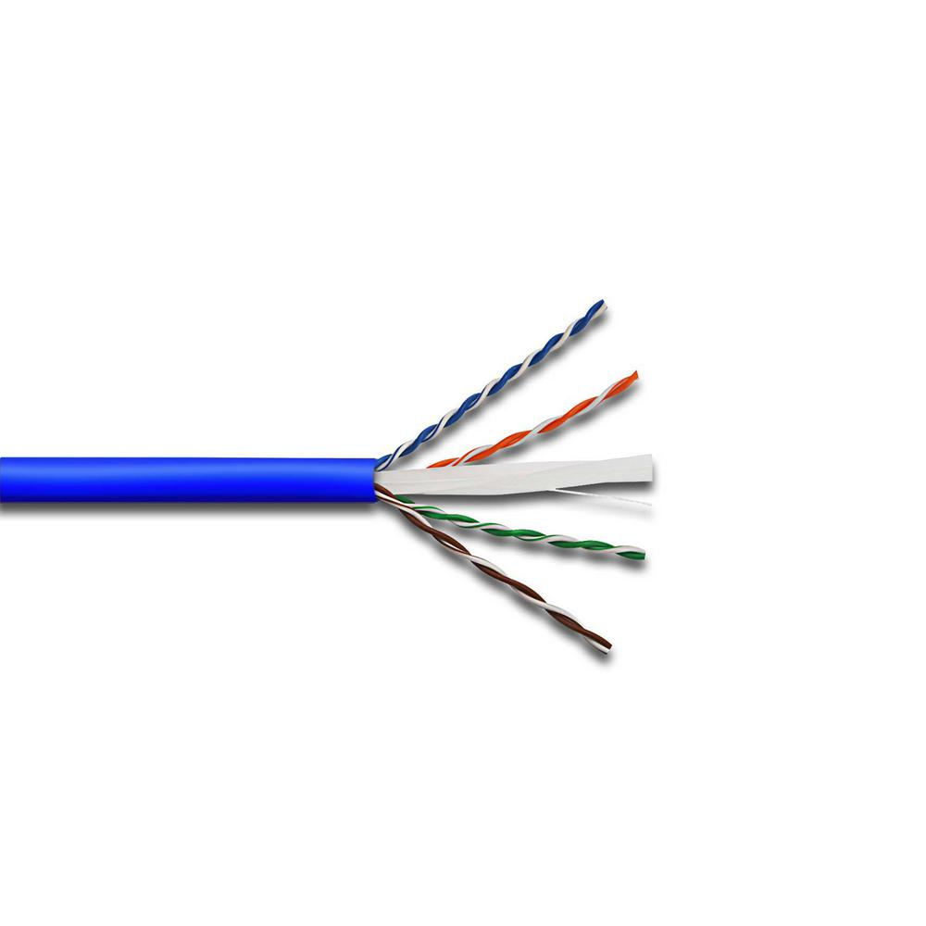
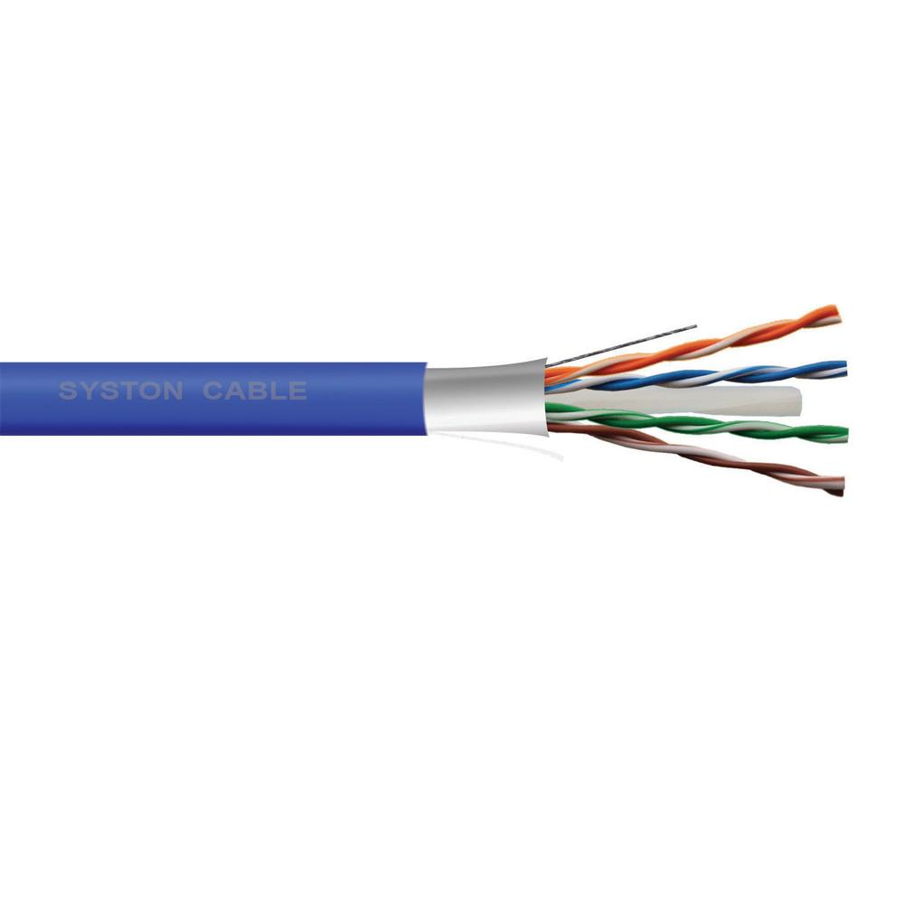
Twisted-Pair Cable
The most common type of network medium used in LAN today
UTP - Unshielded Twisted pair
STP - Shielded Twisted pair
Cheaper
Easy to work
High transmission
Notes:
Twisted-pair cable is the most common type of cabling you can see in today's Local Area Networks (LAN) networks. A pair of wires forms a circuit that can transmit data. The pairs are twisted to provide protection against crosstalk. Crosstalk is the undesired signal noise generated by the electromagnetic fields of the adjacent wires.
When a wire is carrying a current, the current creates a magnetic field around the wire. This field can interfere with signals on nearby wires. To eliminate this, pairs of wires carry signals in opposite directions, so that the two magnetic fields also occur in opposite directions and cancel each other out. This process is known as cancellation.
Two types of twisted pair cables are Unshielded Twisted Pair (UTP) and Shielded Twisted Pair (STP).
Unshielded Twisted Pair (UTP) cable is the most common networking media. Unshielded Twisted Pair (UTP) consists of four pairs of thin, copper wires covered in color-coded plastic insulation that are twisted together. The wire pairs are then covered with a plastic outer jacket.
Shielded Twisted Pair (STP) cables additionally have an overall conducting metallic shields covering four twisted pair wires. There may be another conducting metallic shields covering individual twisted pairs also. These metallic shields blocks out electromagnetic interference to prevent unwanted noise from the communication circuit.
This cable type is the most common today for the following reasons:
It’s cheaper than other types of cabling.
It’s easy to work with. Easy to bend.
It allows transmission rates that were impossible 10 years ago.

Slide 8
Twisted-Pair Cable
N <Signaling> X
N: Signaling rate in Mbps
<Signaling>: Signalling type (baseband or broadband)
X: Unique identifier
Examples:
10Base-T: 10Mb or 10Megabits twisted pair
100Base-F: 100Mb or 100Megabits fiber
Notes:
Ethernet cable types are described using a code that follows this format: N <Signaling> X. The N refers to the signaling rate in megabits per second. <Signaling> stands for the signaling type—either baseband or broadband—and the X is a unique identifier for a specific Ethernet cabling scheme.
Here’s a common example: 100Base-X. The 100 tells us that the transmission speed is 100 Mb, or 100 megabits. The X value can mean several different things; for example,
a T is short for twisted-pair
F is short for fiber
5 means thicknet
2 means thinnet

Slide 9
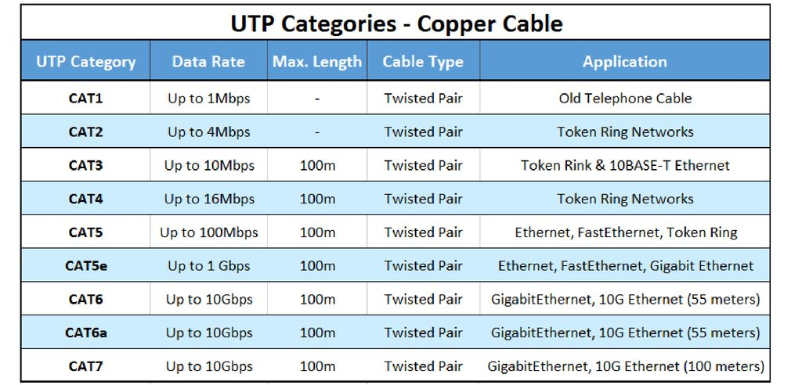
Twisted-Pair Cable

Slide 10
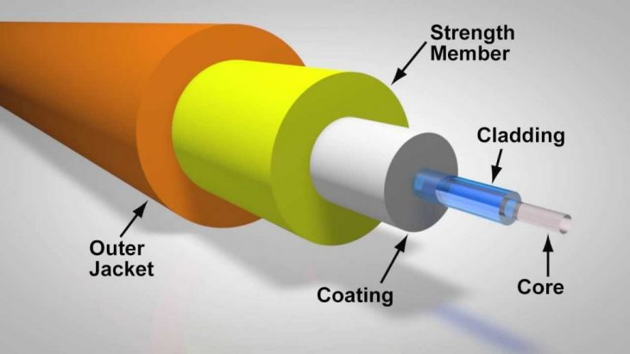
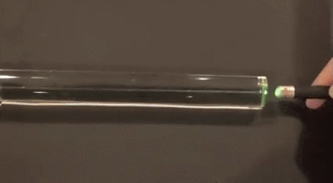
Fiber-Optic Cable
Very thin strand of pure glass that acts as a waveguide for light over long distances
Total internal reflection
Notes:
Optical fiber is a very thin strand of pure glass that acts as a waveguide for light over long distances. It uses a principle known as total internal reflection.
Fiber optic cable is actually composed of two layers of glass: The core, which carries the actual light signal, and the cladding, which is a layer of glass surrounding the core. The cladding has a lower refractive index than the core. This causes Total Internal Reflection within the core. Most fibers operate in duplex pairs: one fiber is used to transmit and the other is used to receive. But it is possible to send both signals over a single strand.

Slide 11

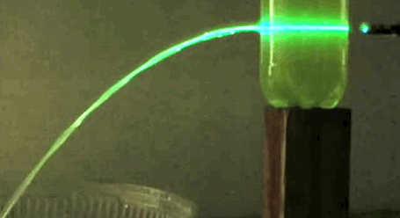
Fiber-Optic Cable
Immune to EMI and RFI*
Difficult to install
Very long range
More expensive than TP
Broad bandwidth (Tbits/s or THz)
Troubleshooting equipment is more expensive then TP test equipment
Low transmission loss
Harder to troubleshoot
Not dissipate heat
*EMI: Electromagnetic interference
RFI: Radio frequency interference
Notes:
Because fiber-optic cable transmits digital signals using light impulses rather than electricity, it’s immune to EMI(Electromagnetic interference) and RFI (Radio frequency interference). Fiber cable allows light impulses to be carried on either a glass or a plastic core. Glass can carry the signal a greater distance, but plastic costs less.
Although fiber-optic cable may sound like the solution to many problems, it has its advantages and disadvantages just like the other cable types.

Slide 12
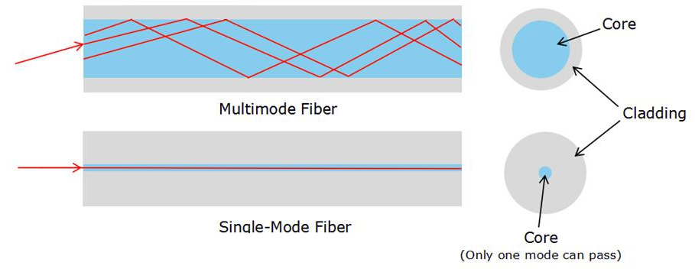
Fiber-Optic Cable
Notes:
Optical fibers carry light signals down them in what are called modes. It just means different ways of traveling: a mode is simply the path that a light beam follows down the fiber. One mode is to go straight down the middle of the fiber. Another is to bounce down the fiber at a shallow angle. Other modes involve bouncing down the fiber at other angles, more or less steep.
The simplest type of optical fiber is called single-mode. It has a very thin core. In a single-mode fiber, all signals travel straight down the middle without bouncing off the edges. Cable TV, Internet, and telephone signals are generally carried by single-mode fibers, wrapped together into a huge bundle. Cables like this can send information over 100 km (60 miles).
Another type of fiber-optic cable is called multi-mode. Each optical fiber in a multi-mode cable is about 10 times bigger than one in a single-mode cable. This means light beams can travel through the core by following a variety of different paths (yellow, orange, blue, and cyan lines)—in other words, in multiple different modes. Multi-mode cables can send information only over relatively short distances and are used (among other things) to link computer networks together.

Slide 13
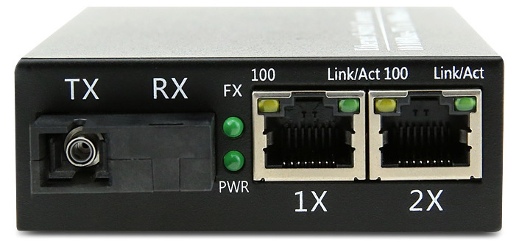
Media Converters
Converts Ethernet or other communication protocols from one cable type to another type
Main types:
Fiber-to-Ethernet
Fiber-to-Coaxial
Fiber-to-Fiber
Ethernet-to-Coaxial
Fiber-to-Ethernet converter
Notes:
A media converter, in the context of network hardware, is a cost-effective and flexible device intended to implement and optimize fiber links in every kind of network. Among media converters, the most often used type is a device that works as a transceiver, which converts the electrical signal utilized in copper unshielded twisted pair (UTP) network cabling to light waves used for fiber optic cabling. It is essential to have the fiber optic connectivity if the distance between two network devices is greater than the copper cabling's transmission distance.
The copper-to-fiber conversion carried out by a media converter allows two network devices having copper ports to be connected across long distances by means of fiber optic cabling.

Slide 14
Cable Properties
2

Slide 15
Cable Properties
Transmission Speeds
Based on the type of cable or fiber, network administrators can control the speed of a network to meet the network’s traffic demands
Media Type | Bandwidth | Performance: Typical Error Rate
Twisted-pair for analog voice applications | 1 MHz | Poor to fair (10^{–5})
Coaxial cable | 1 GHz | Good (10^{–7} to 10^{–9})
Microwave | 100 GHz | Good (10^{–9})
Satellite | 100 GHz | Good (10^{–9})
Fiber | 75 THz | Great (10^{–11} to 10^{–13})
Notes:
Based on the type of cable or fiber you choose and the network that it’s installed in, network administrators can control the speed of a network to meet the network’s traffic demands.
Admins usually permit or would like to have, transmission speeds of up to 10 Gbps or higher on the core areas of their networks that connect various network segments. In the distribution and access areas, where users connect to switches, it’s typically 100 Mbps per connection, but transmission speeds are creeping up because the traffic demand is getting higher.

Slide 16
Cable Properties
Distance
Standard | Data Rate | Max Distance | Cable Type
10Base2 | 10 Mbps | 185 m | Coaxial
10Base5 | 10 Mbps | 500 m | Coaxial
10BaseT | 10 Mbps | 100 m | Ethernet
100BaseT | 100 Mbps | 100 m | Ethernet
1000BaseT | 1 Gbps | 100 m | Ethernet
10BaseFL | 10 Mbps | 2 km | Fiber (Multi Mode)
100BaseSX | 100 Mbps | 300 m | Fiber (Multi Mode)
100BaseLX | 100 Mbps | 100 km | Fiber (Single Mode)
1000BaseLH | 1 Gbps | 70 km | Fiber (Single Mode)
Notes:
Deciding factors used in choosing what cable type to use often come down to the topology of a network and the distance between its components. Some network technologies can run much farther than others without communication errors, but all network communication technologies are prone to attenuation—the degradation of a signal due to the medium itself and the distance signals have to travel. Some cable types suffer from attenuation more than others. For instance, any network using twisted-pair cable should have a maximum segment length of only 328 feet (100 meters).

Slide 17
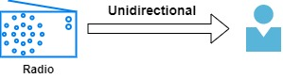
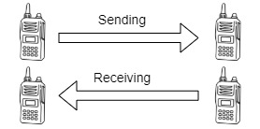

Cable Properties
Simplex
Half-duplex
Full-duplex
Notes:
Simplex mode:
In simplex mode, Sender can send the data but can’t receive any data. It is a unidirectional communication.
Half-duplex mode:
In half duplex mode, Sender can send the data and also can receive the data but one at a time. It is two-way directional communication but one at a time.
Full duplex mode:
In full duplex mode, Sender can send the data and also can receive the data simultaneously. It is two-way directional communication simultaneously.

Slide 18

THANKS!
Any questions?

